Slide 1
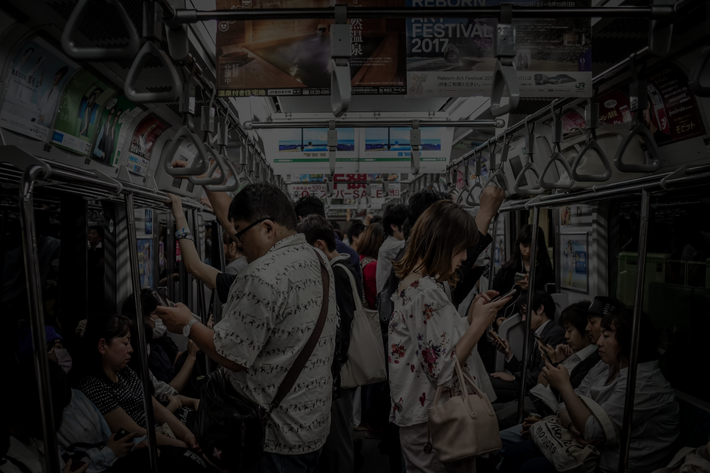
Use of Social Media vs Invasion of Privacy
Examining the Psychological Drivers of Social Media Usage

Slide 2

Research Framework
Independent Variable (IV): Psychological Drivers of Social Media Usage
The psychological motivations influencing individuals' utilization of social media platforms.
Dependent Variable (DV): Platform Usage Decision
Decisions made by individuals regarding their engagement with social media platforms.

Slide 3
Privacy Paradox
Benefits
Concerns
Despite privacy concerns, social media offers a platform for staying connected with friends and family worldwide.
Social media allows individuals to express themselves freely and showcase their creativity through posts and updates.
Engaging with social media can provide opportunities for networking and career advancement through online connections.
Users may unknowingly share personal information that could be exploited by malicious actors for identity theft or fraud.
Social media platforms track user behavior and preferences, leading to targeted advertisements and potential invasion of privacy.
Oversharing on social media can result in unintended consequences, such as sharing sensitive information with a wider audience than intended.

Slide 4
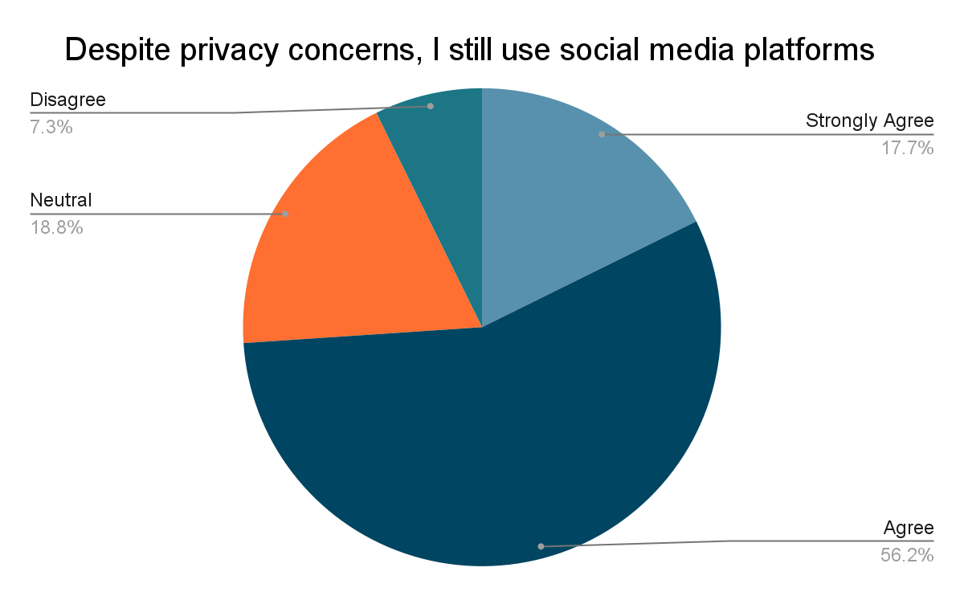
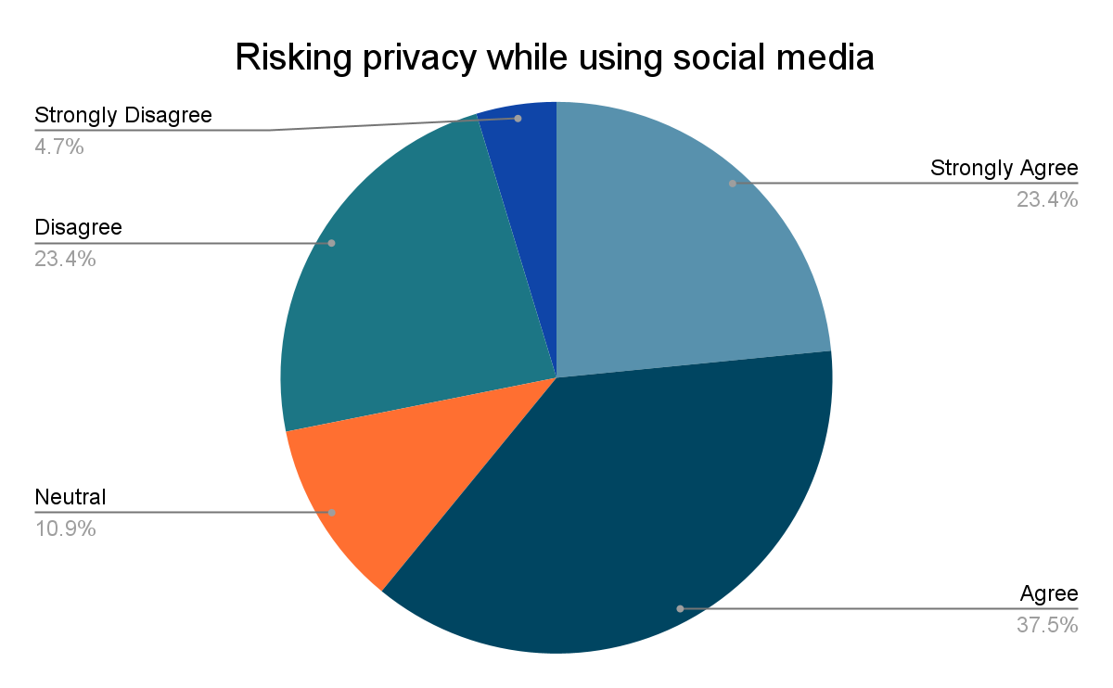
Why a Paradox?
Most users kept using social media apps without being concerned about their privacy
60% of the users that responded to the survey felt that their privacy got invaded while using these apps

Slide 5

Driving Factors
Connectivity and Networking
Information and Entertainment
FOMO (Fear of Missing Out)
Convenience and Accessibility
Escapism and Distraction
Social Influence and Trends
User Habituation

Slide 6
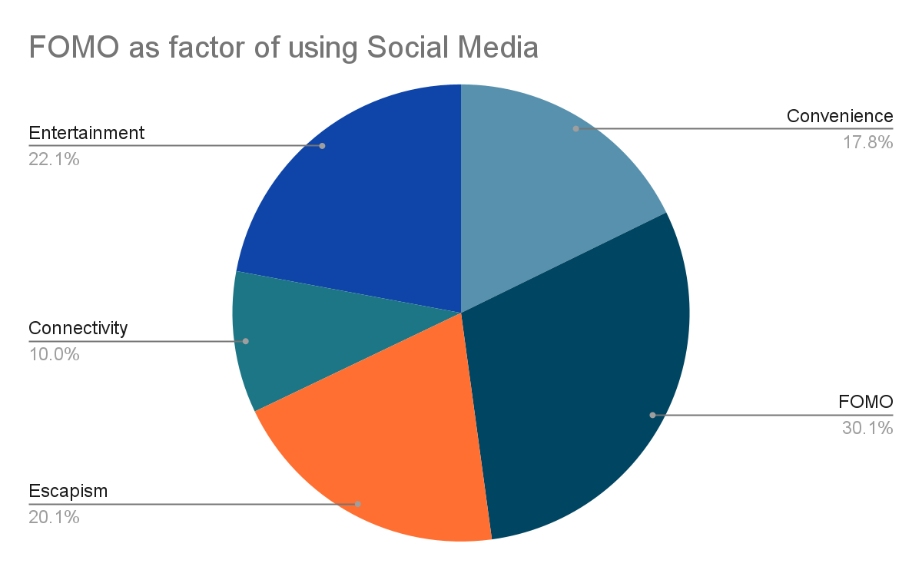
FOMO as the driving factor
From the interviews and surveys conducted, the leading factor for using Social media was found out to be FOMO or the Fear Of Missing Out

Slide 7
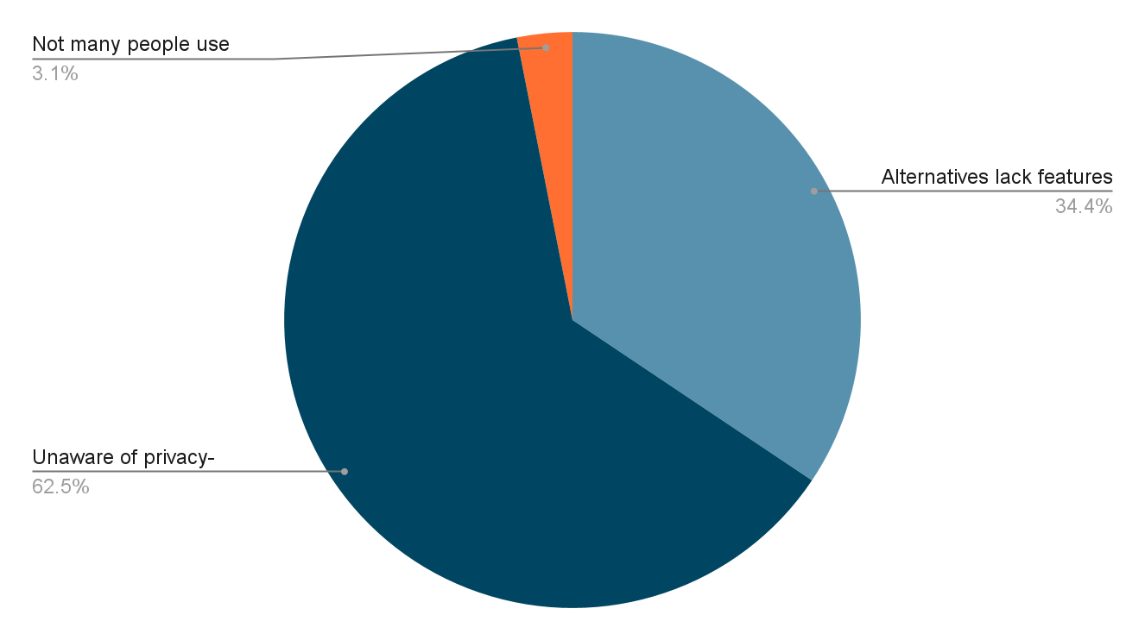
The factors that prevent me from making a switch to alternative social media platforms that prioritize privacy
Not many people use it
Unaware of privacy-focused alternatives
Alternatives lack features I need

Slide 8
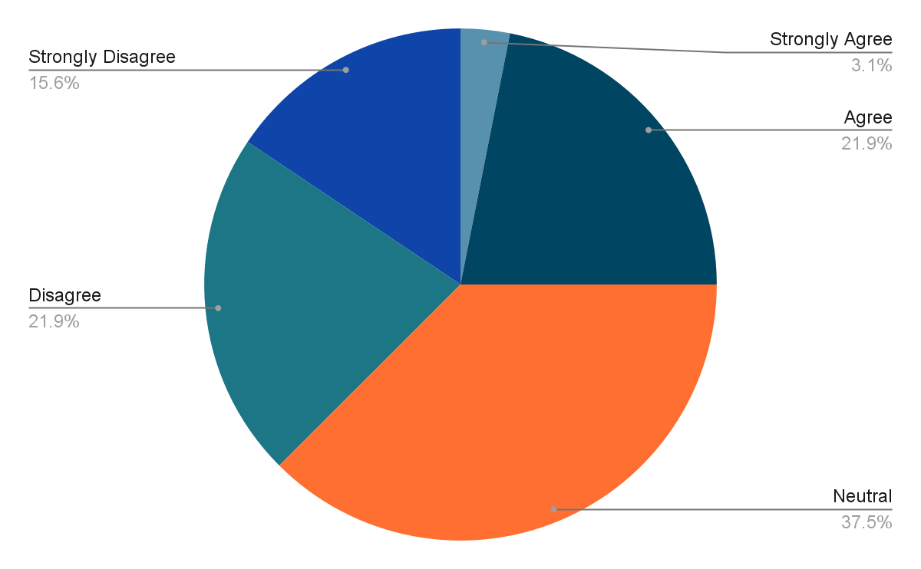
Social media platforms prioritize user privacy over business interest
Strongly Agree
Agree
Neutral
Disagree
Strongly Disagree

Slide 9
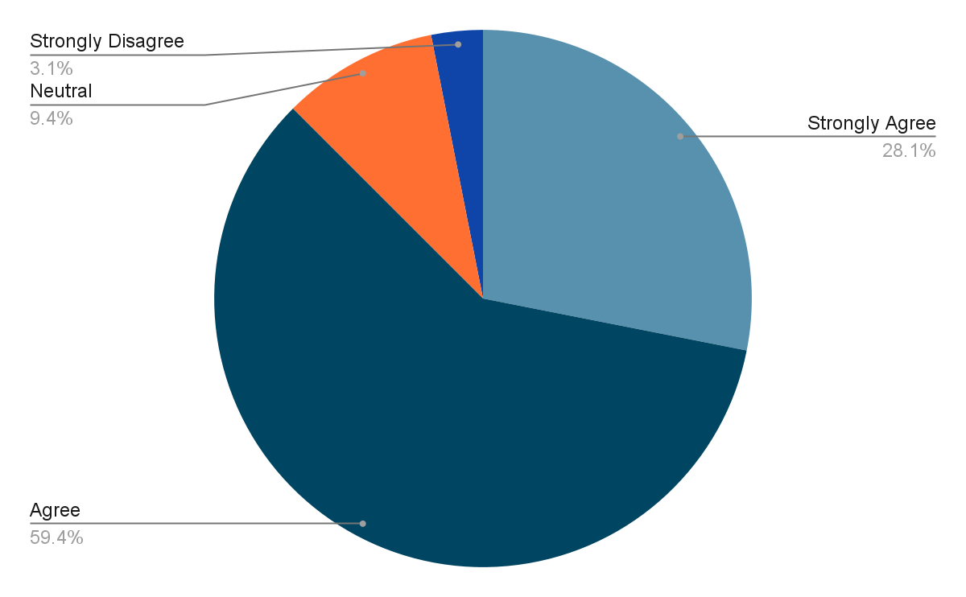
Social media platforms should be more transparent about how they collect and use data
Strongly Agree
Agree
Neutral
Disagree
Strongly Disagree

Slide 10
Recent Events
Twitter data sharing
Snapchat data breach
Amazon Privacy Violations Involving Alexa and Ring

Slide 11
Twitter data sharing
User information shared without people’s permission.
Including country code of the user based on the disclosed location, their engagement levels with respect to the ads run by Twitter partners.
If you clicked or viewed an advertisement for a mobile application and subsequently interacted with the mobile application since May 2018, we may have shared certain data (e.g., country code, if you engaged with the ad and when, information about the ad, etc) with trusted measurement and advertising partners, even if you didn't give us permission to do so. (Source)
Issues fixed on August 5, 2019. Investigations conducted to determine individuals impacted.

Slide 12
Snapchat data breach
UK student faced trial over private snapchat message. (Source)
He claimed to be a member of the Taliban in jest and joked about blowing up the plane. (Source)
The method by which the British security services accessed the private communication remains unclear
Unlikely that other participant in chat reported the message due to quick response.
Verma’s case suggests that messages can be intercepted or disclosed under certain conditions

Slide 13
Amazon Privacy Violations Involving Alexa and Ring
User voice transcripts were retained and used by Amazon without proper consent. (Source)
Amazon-owned Ring was allowing employees to access customer video recordings without consent.
Amazon was accused of illegally collecting children’s voice and geolocation data through Alexa.
The settlements require Amazon to delete certain data and implement new security measures to prevent future privacy breaches.

Slide 14

Data Usage by Social Media Platforms
Social media platforms collect user data for targeted ads and personalized content.
Facebook, Twitter, and Instagram use data to improve ad relevance and engagement.
User data is also used by social media platforms to analyze trends and behavior.

Slide 15
Literature Review
Privacy attitudes and privacy behaviour: A review of current research on the privacy paradox phenomenon - ScienceDirect
Revisiting the Privacy Paradox on Social Media: An Analysis of Privacy Practices Associated with Facebook and Twitter | Canadian Journal of Communication
A New Privacy Paradox: Young People and Privacy on Social Network Sites

Slide 16
Thank You

